Slide 1


ONLINE FERTILIZER INFORMATION SYSTEM
FACULTY CO-ORDINATOR: Mr.D.PRASAD
DONE BY:
B.HARSHAVARDHAN-319126510073
E.VIJAYADURGA-319126510078
G.SRIKANTH-319126510085
M.BHARGAVI-319126510095

Slide 2

PROBLEM STATEMENT
In this,we are aiming to create a website to suggest the type of fertilizer they have to use to get better yield.

Slide 3

DESCRIPTION
OFIS is an option to suggest fertilizer to a crop by suggesting how to use and when to use based on the crop criteria.
Using an online fertilizer info system, they can identify what fertlizer can be used to crop and how to get the best yield based on our suggestion.

Slide 4

OBJECTIVE
This system is an option to get best yield for a particular type of crop. This system also says what are the diseases controlled by using our recommended fertilizers for that crop. This system also specifies compatibility range of that product.

Slide 5


PURPOSE:
The purpose of this project is to implement fertilizer information system that allows the users to check the fertilizer they have to use to get good yield for a particular crop.
SCOPE:
Through this, the users will get best yield and quality products.

Slide 6
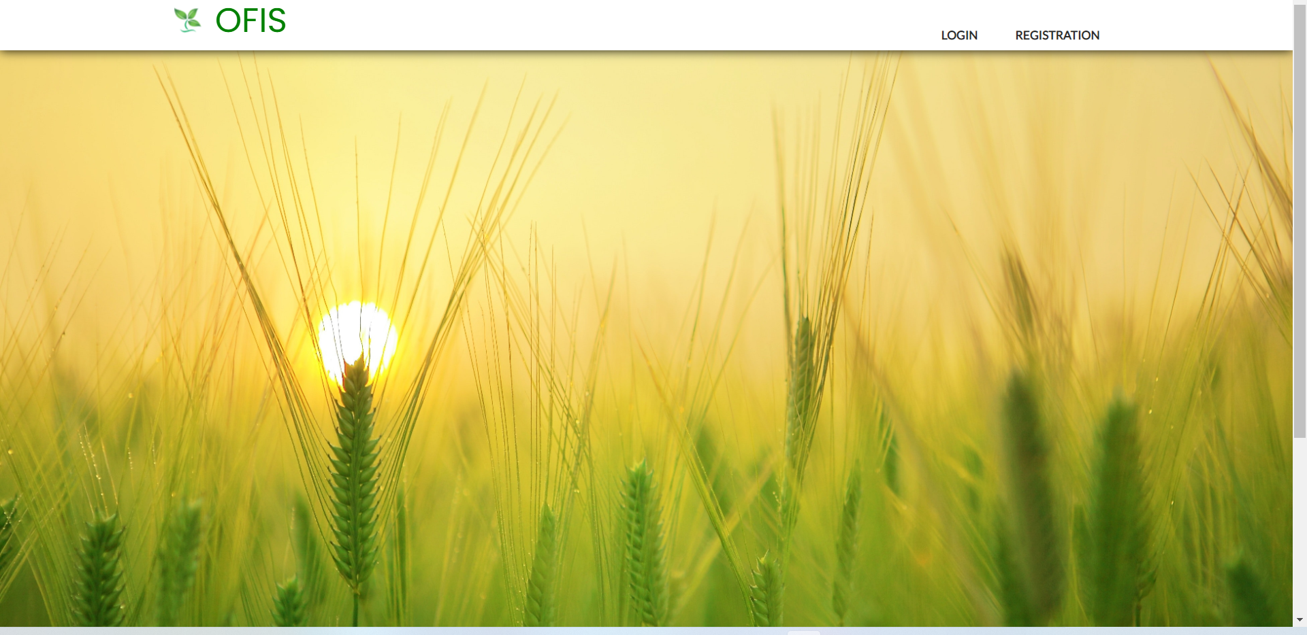
Getting started into our website:

Slide 7

Login page:if customer already have an account he has to login into website

Slide 8
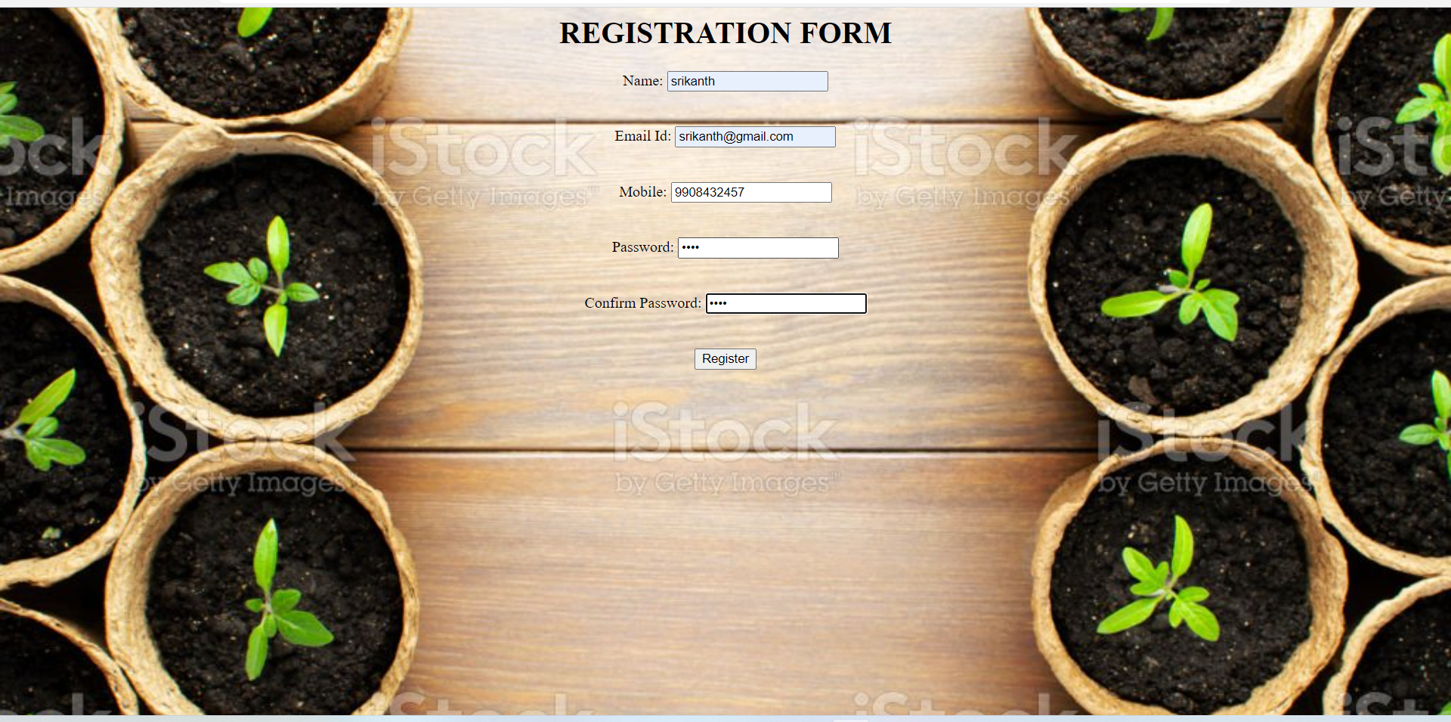
Registration form:if user is new to website they have to register

Slide 9
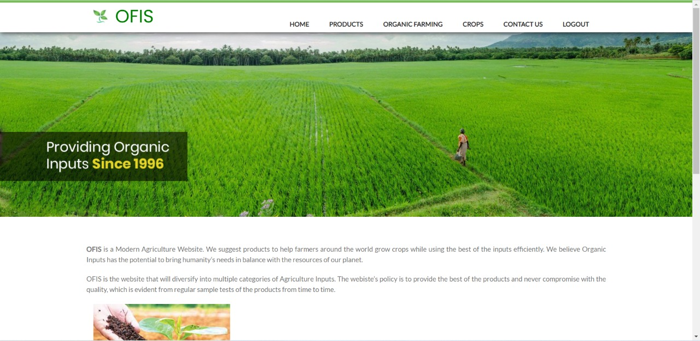
After logging into website:

Slide 10
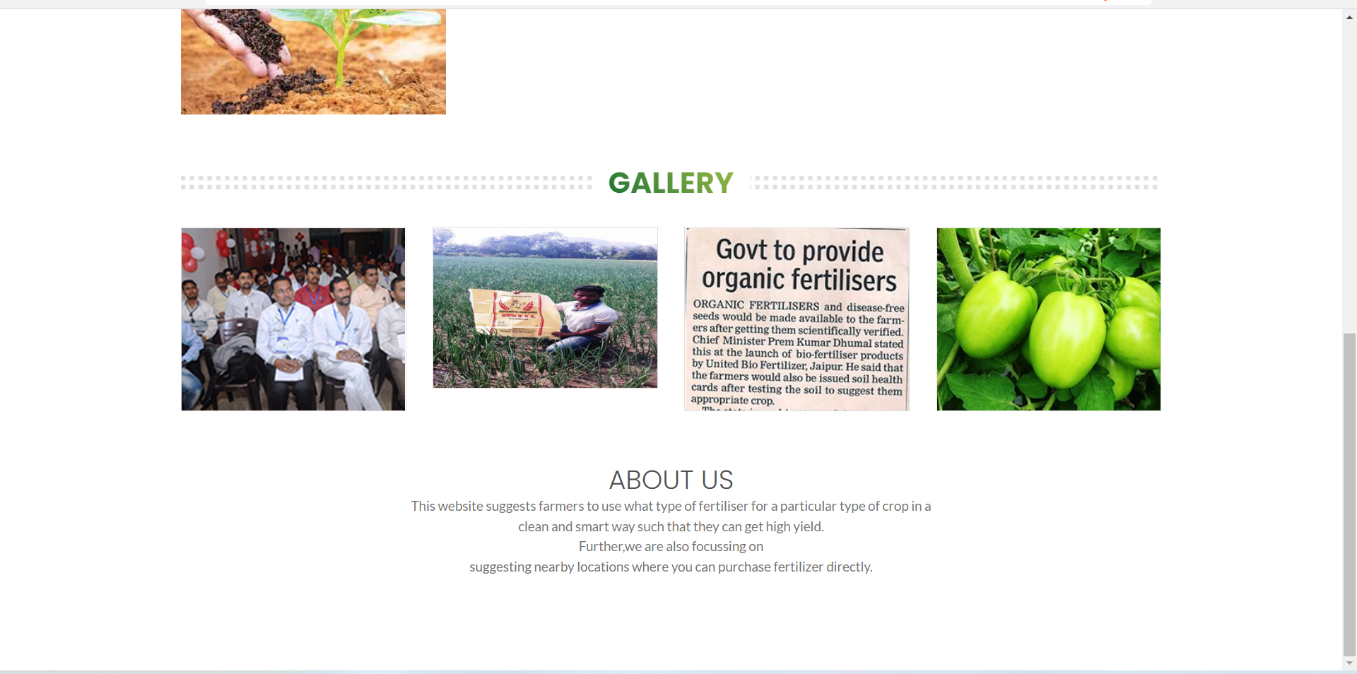

Slide 11
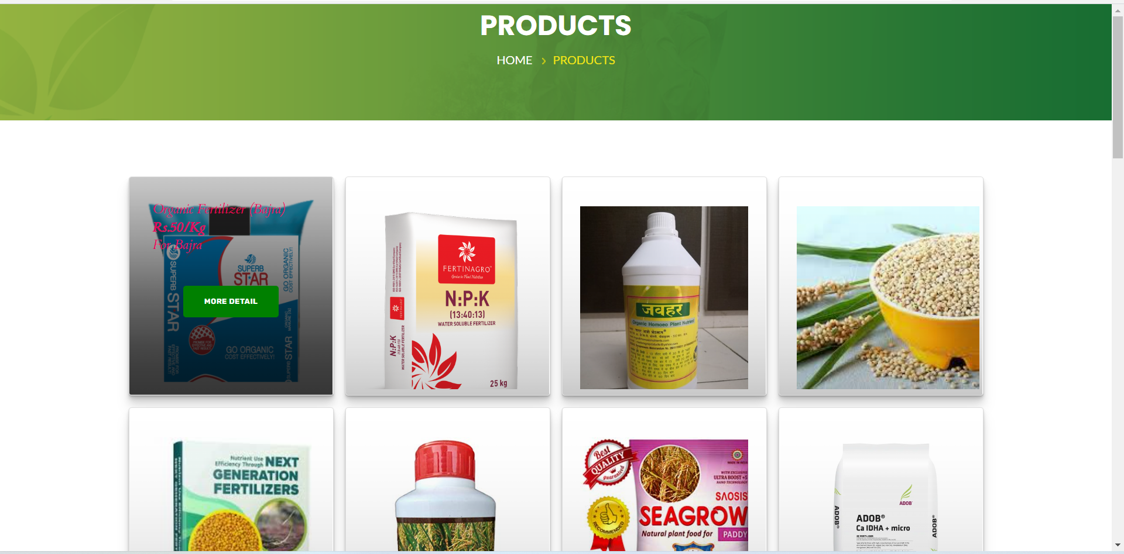
Products page:

Slide 12
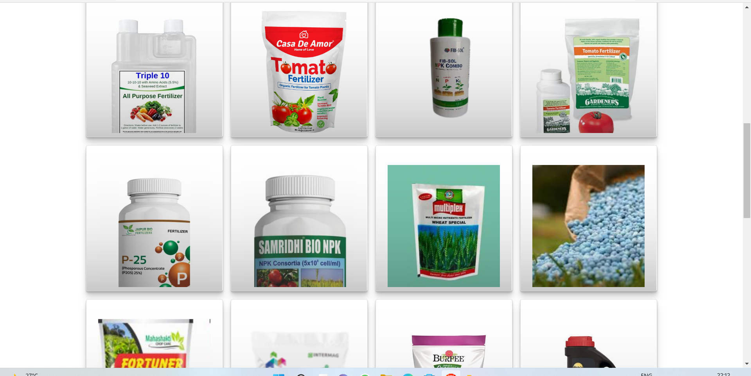

Slide 13
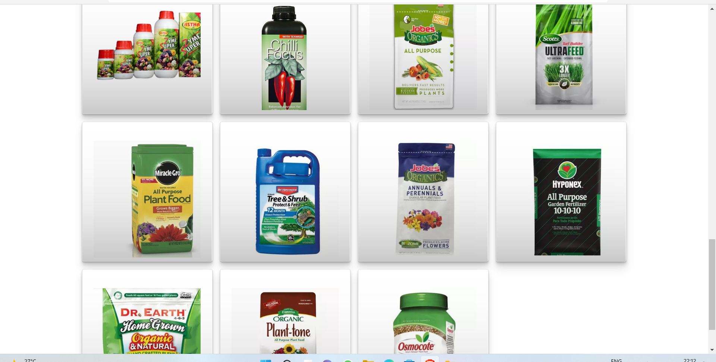

Slide 14
Organic farming pages:

Slide 15
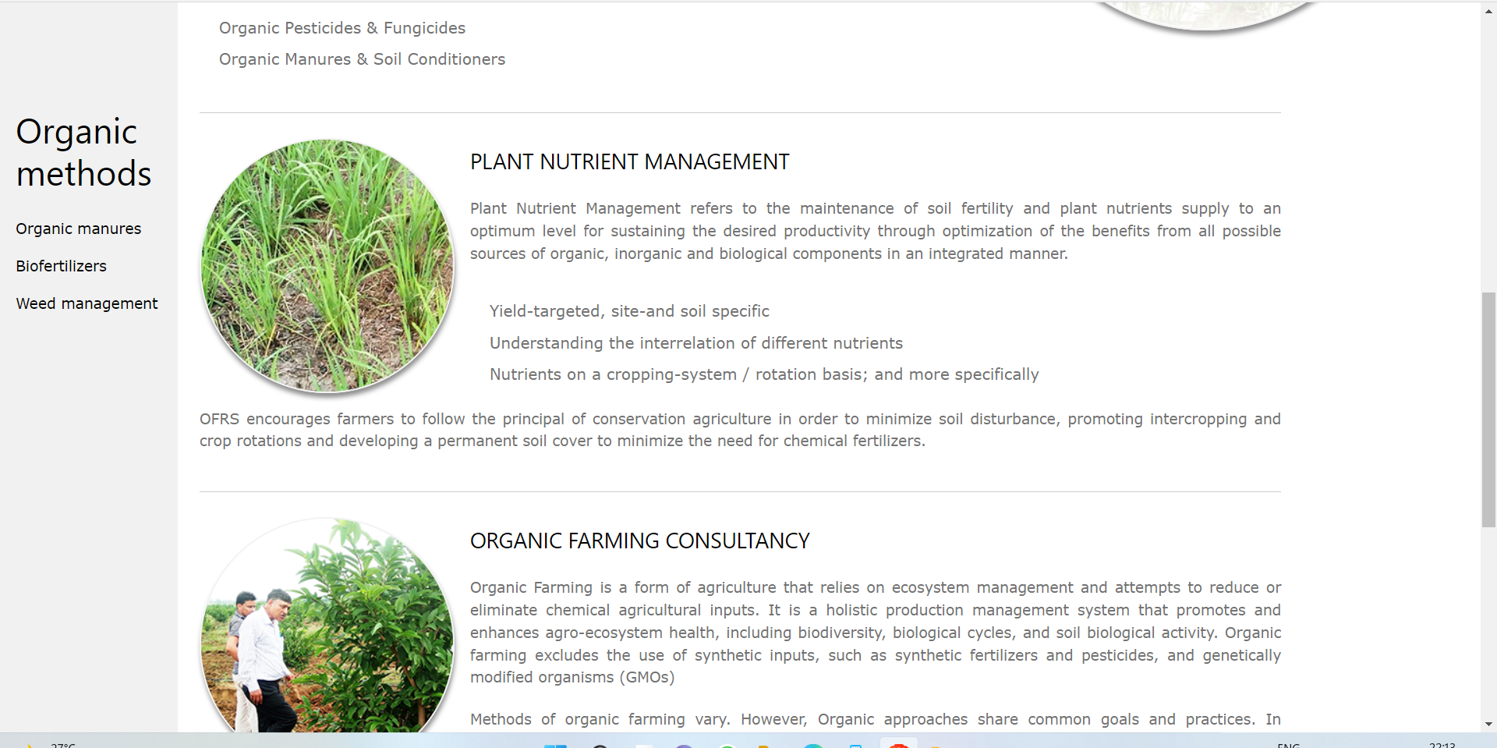

Slide 16
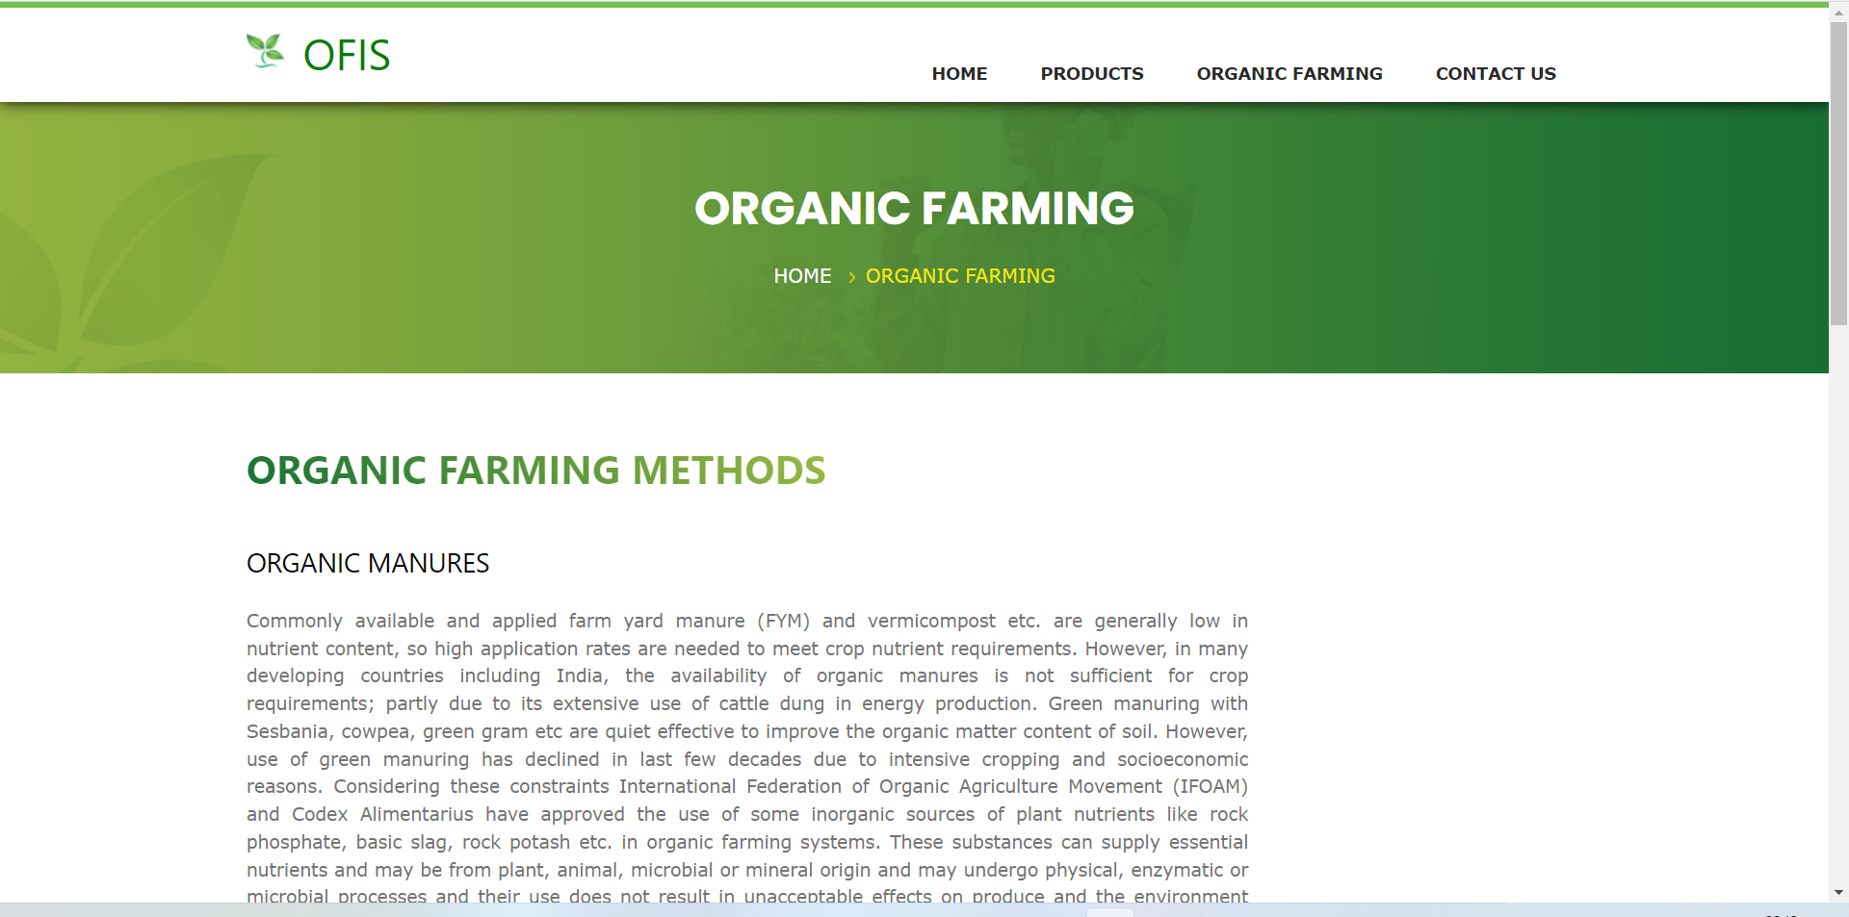

Slide 17
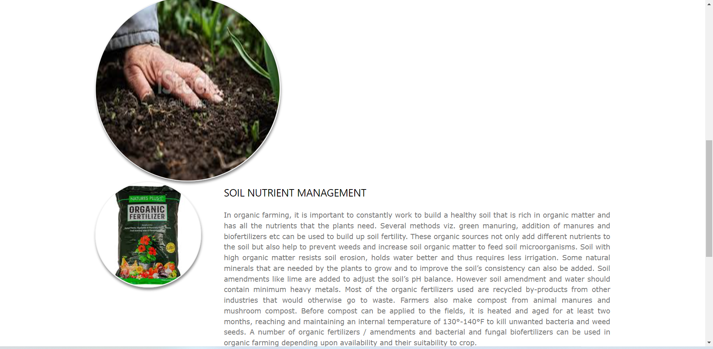

Slide 18
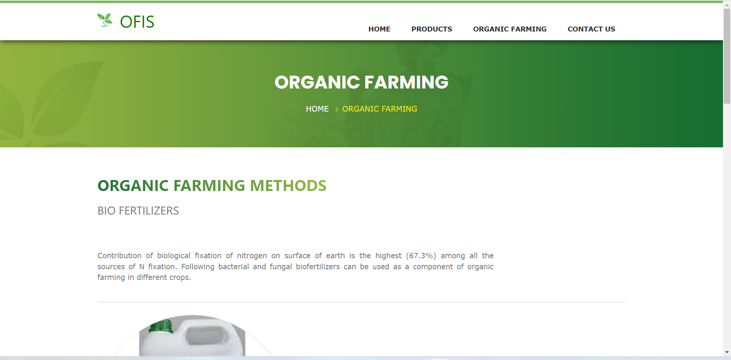
crops:

Slide 19
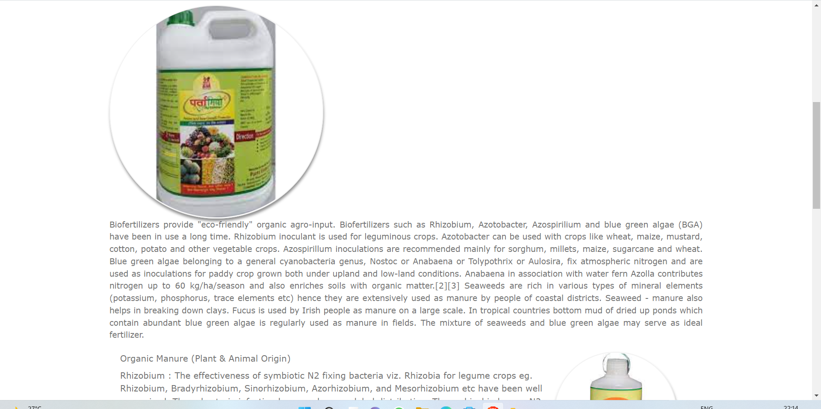

Slide 20
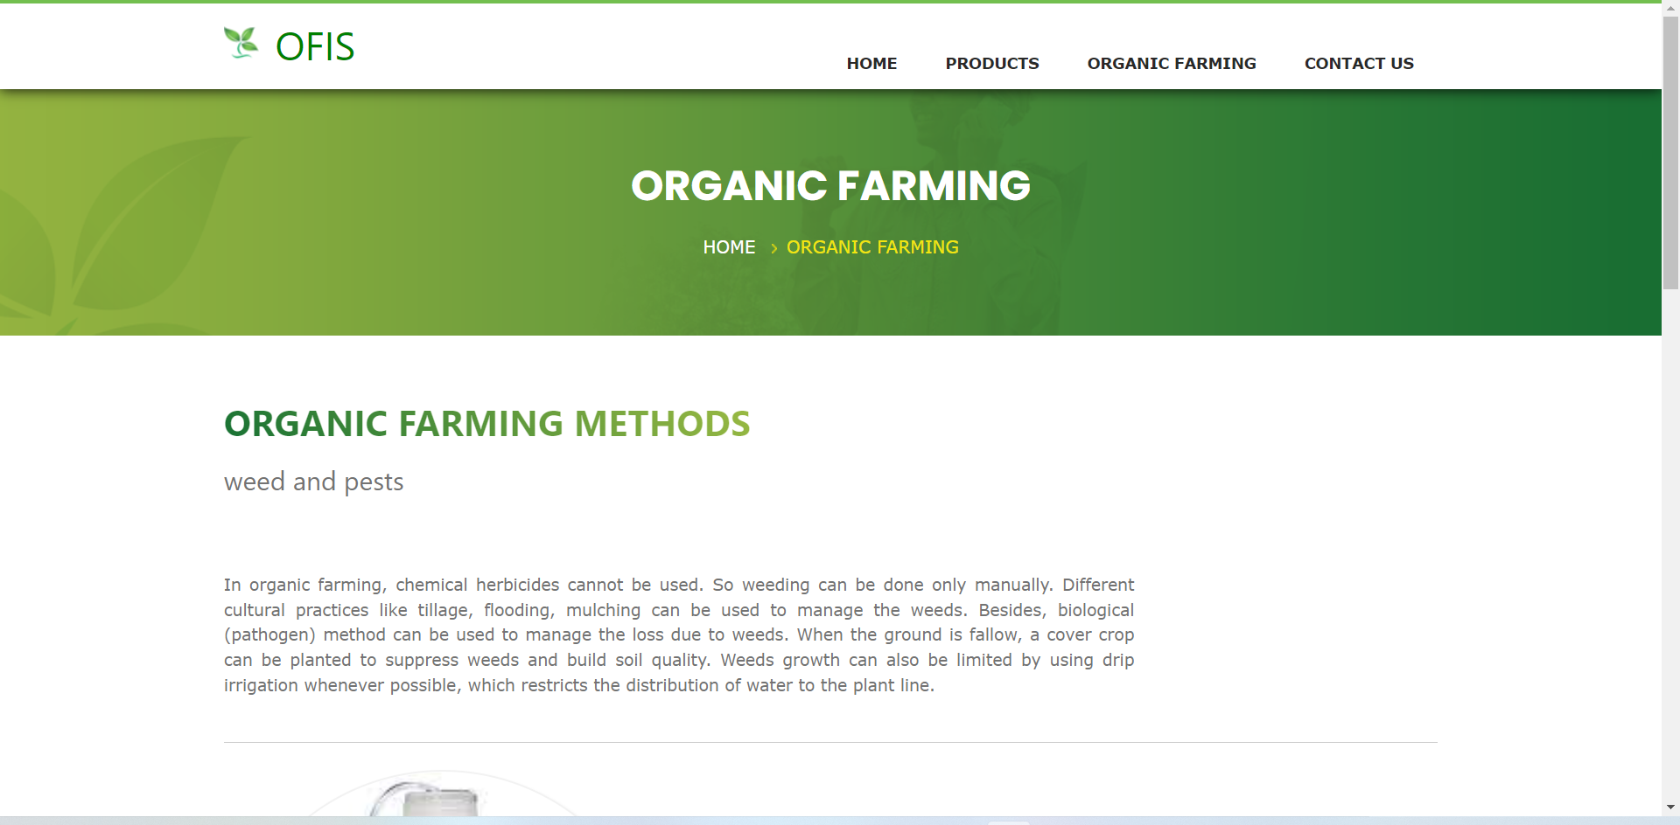

Slide 21
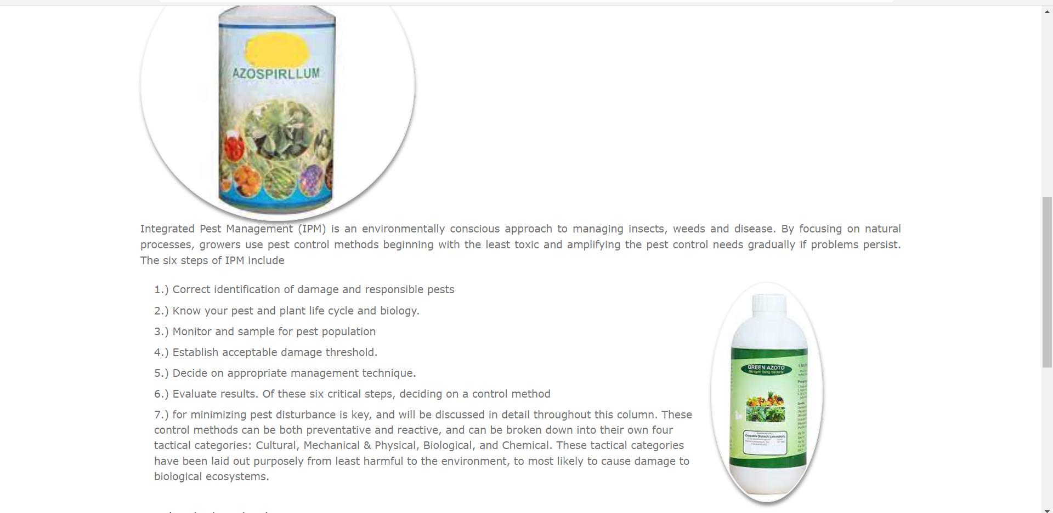

Slide 22
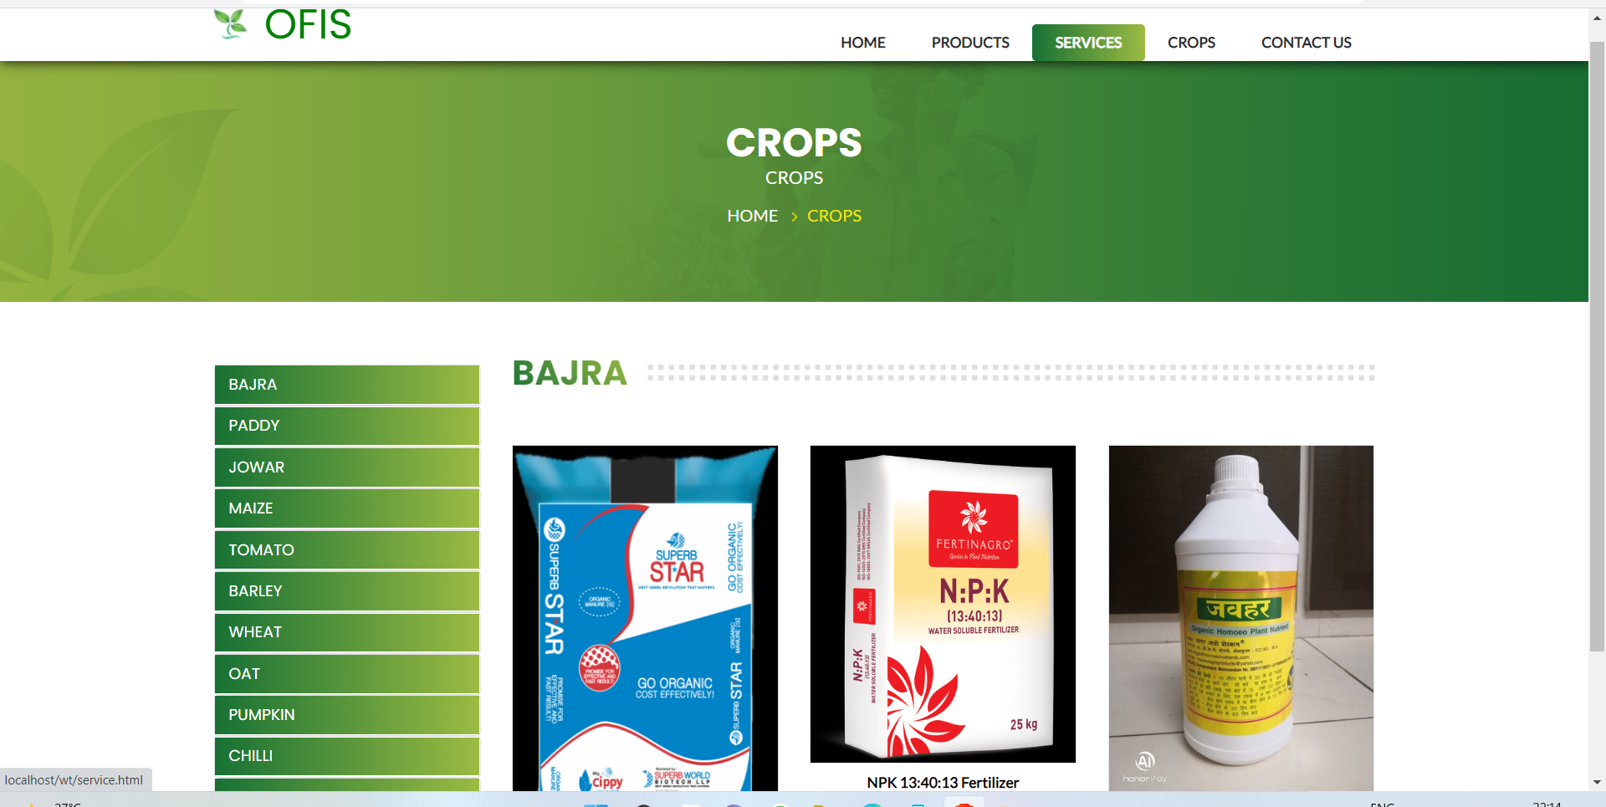

Slide 23
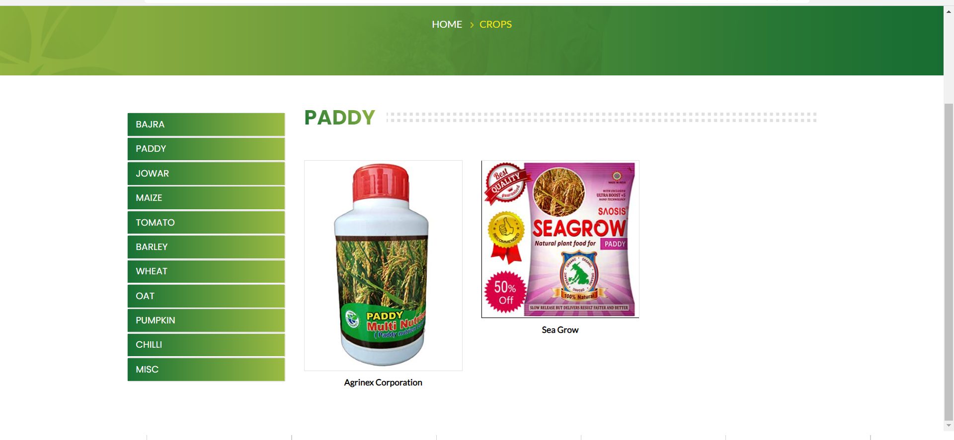

Slide 24
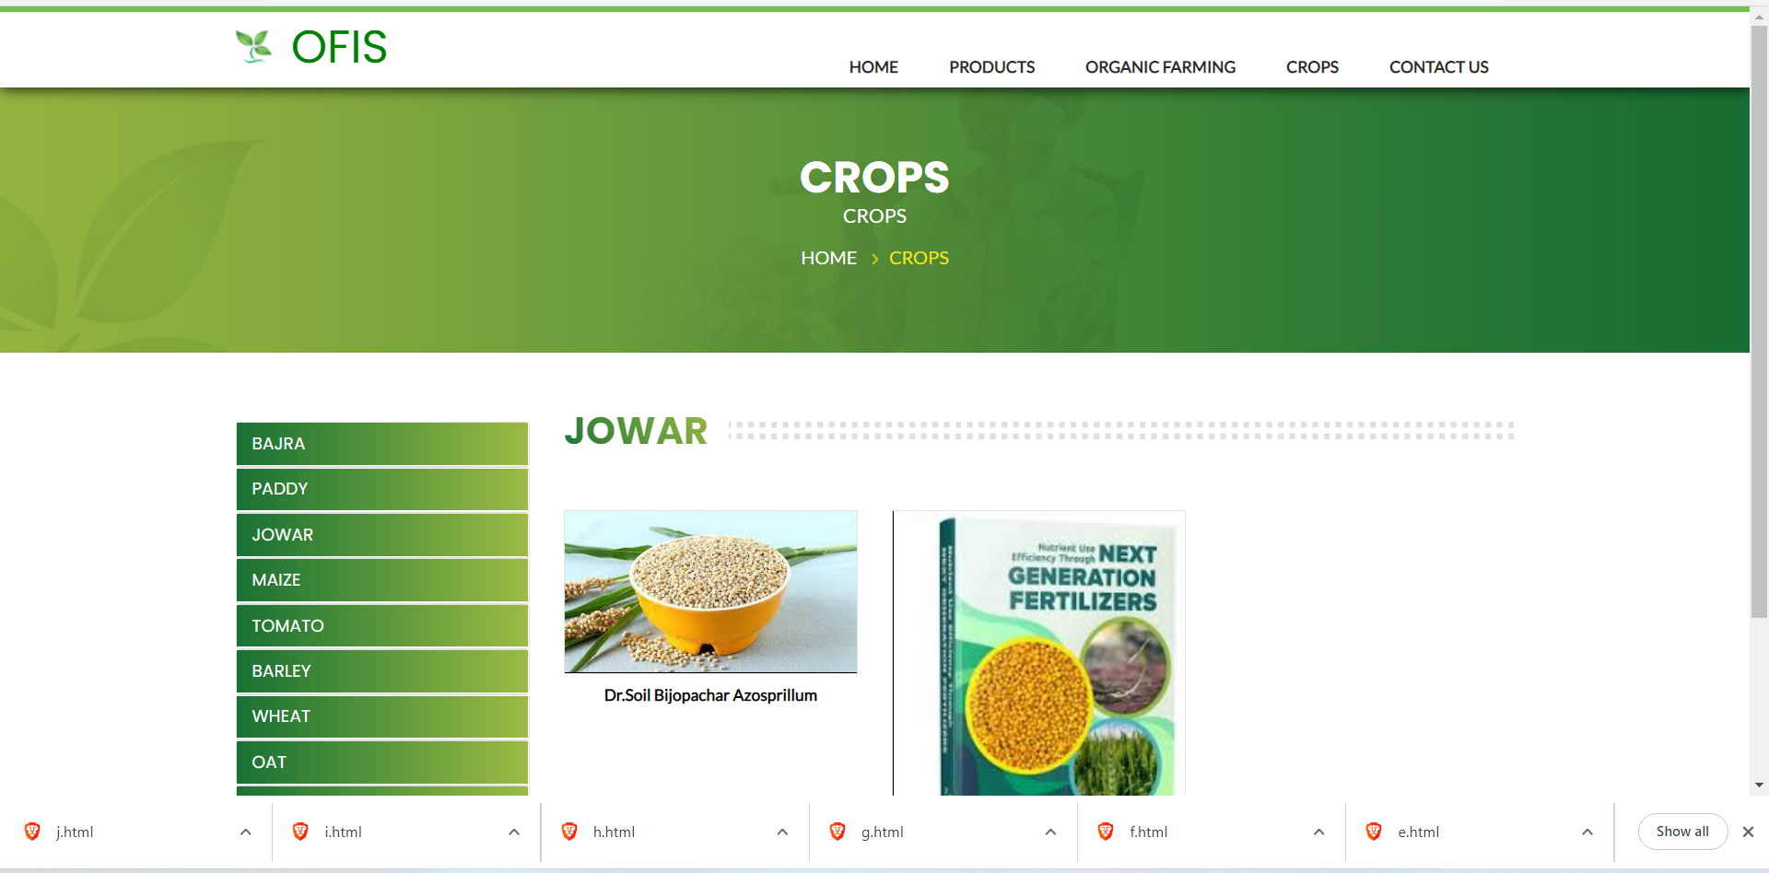

Slide 25
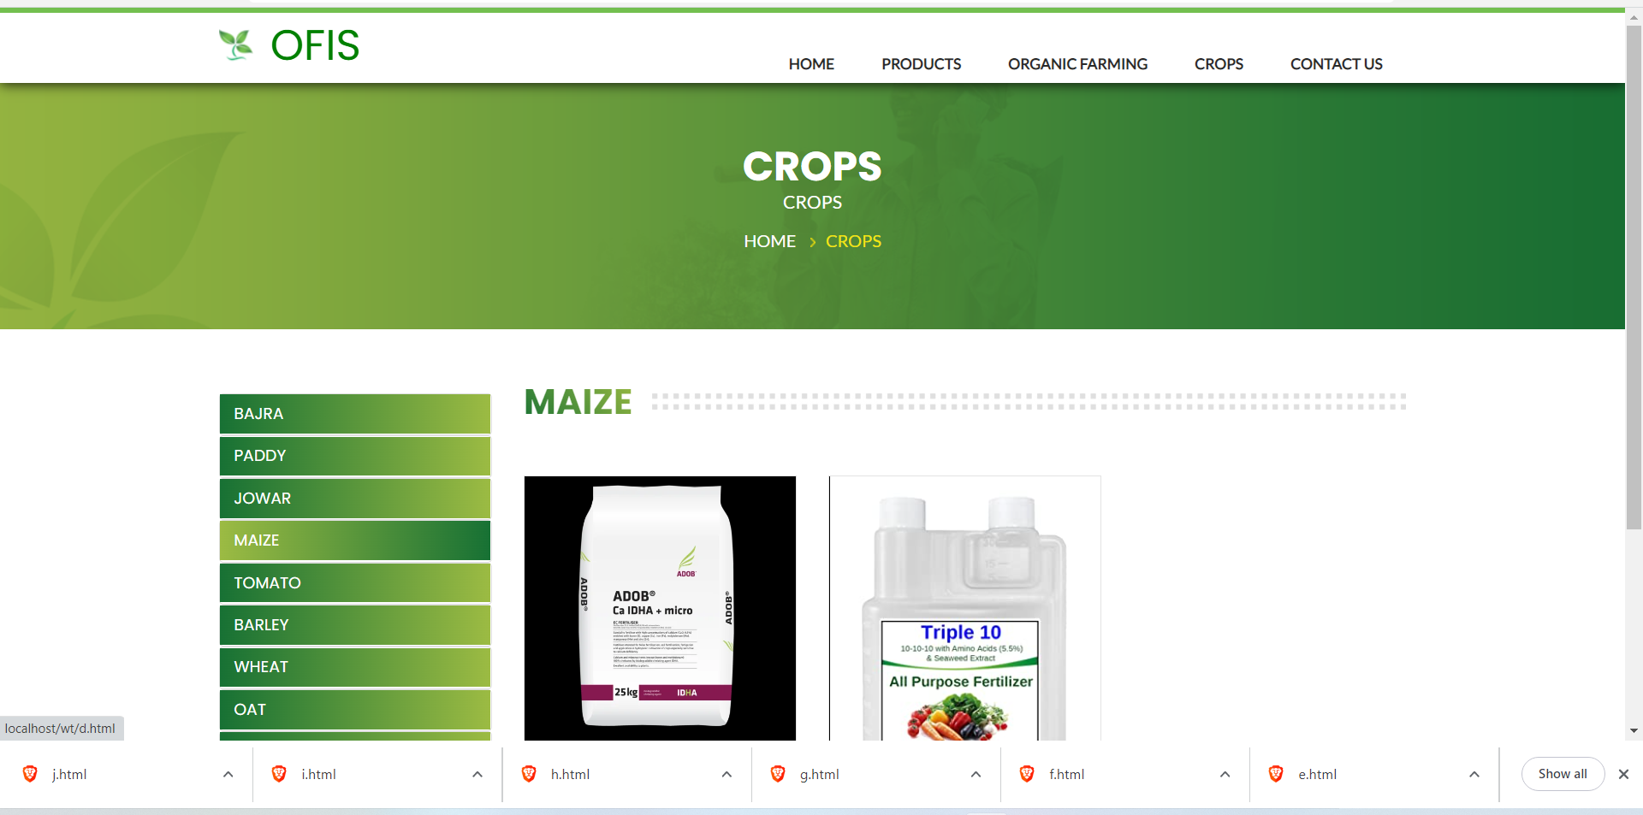

Slide 26
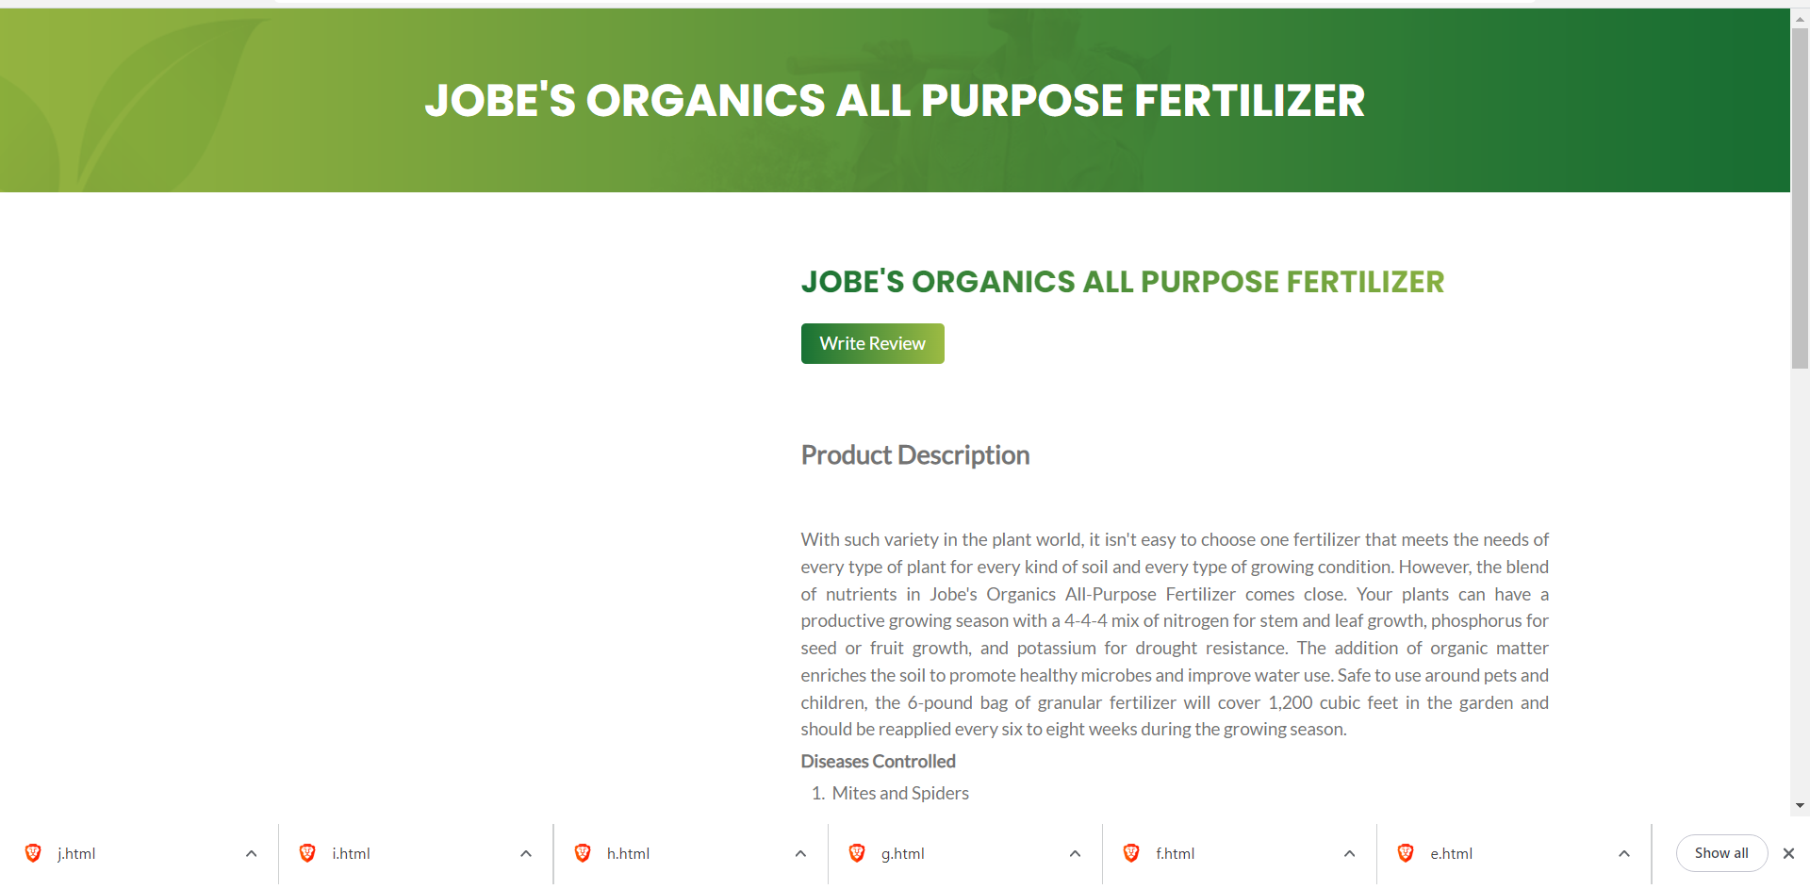

Slide 28
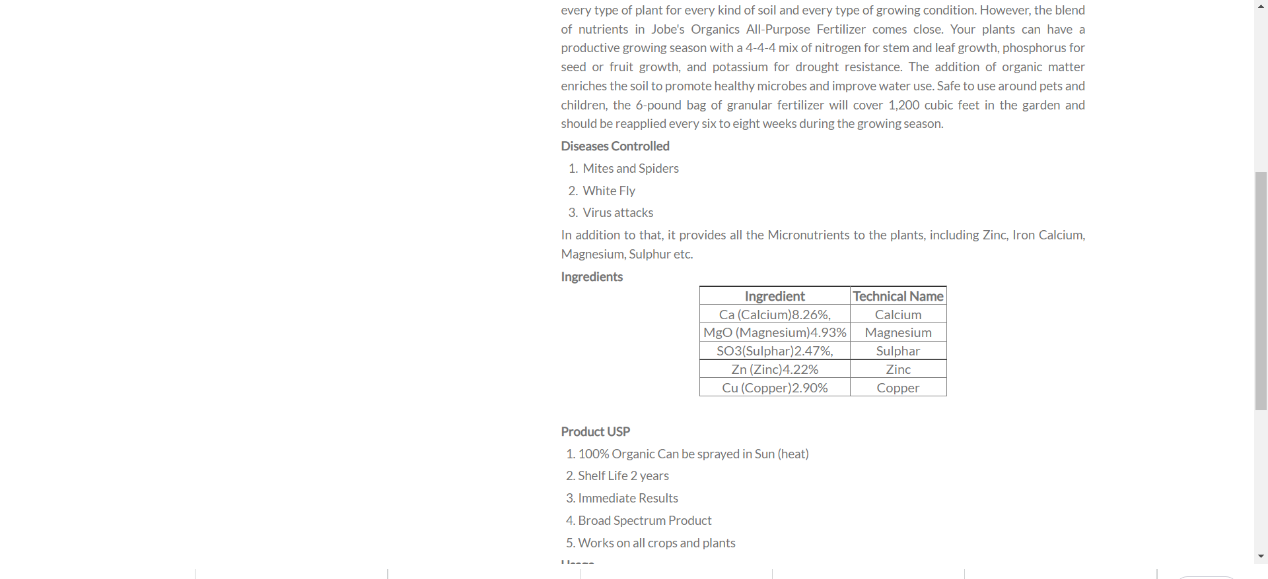

Slide 29
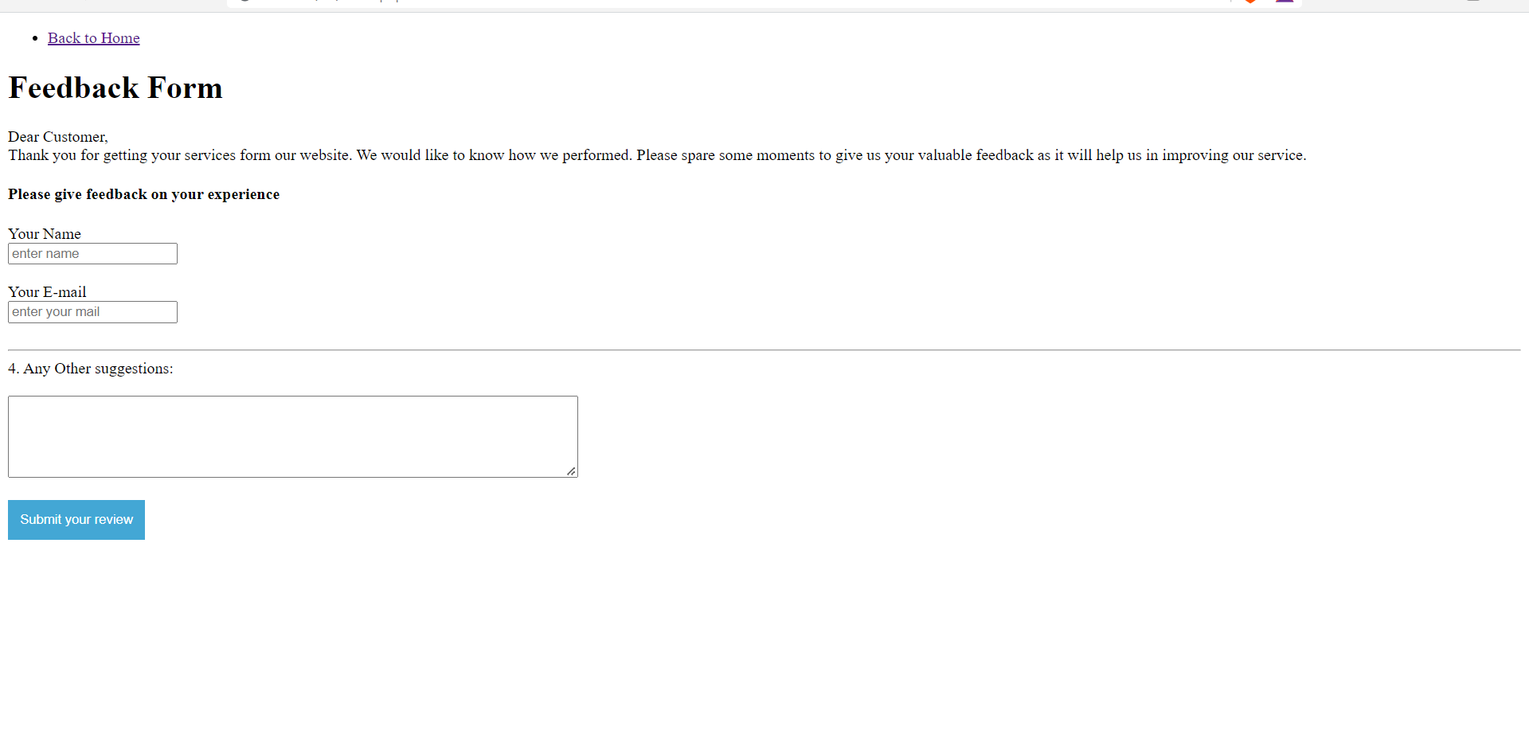

Slide 30
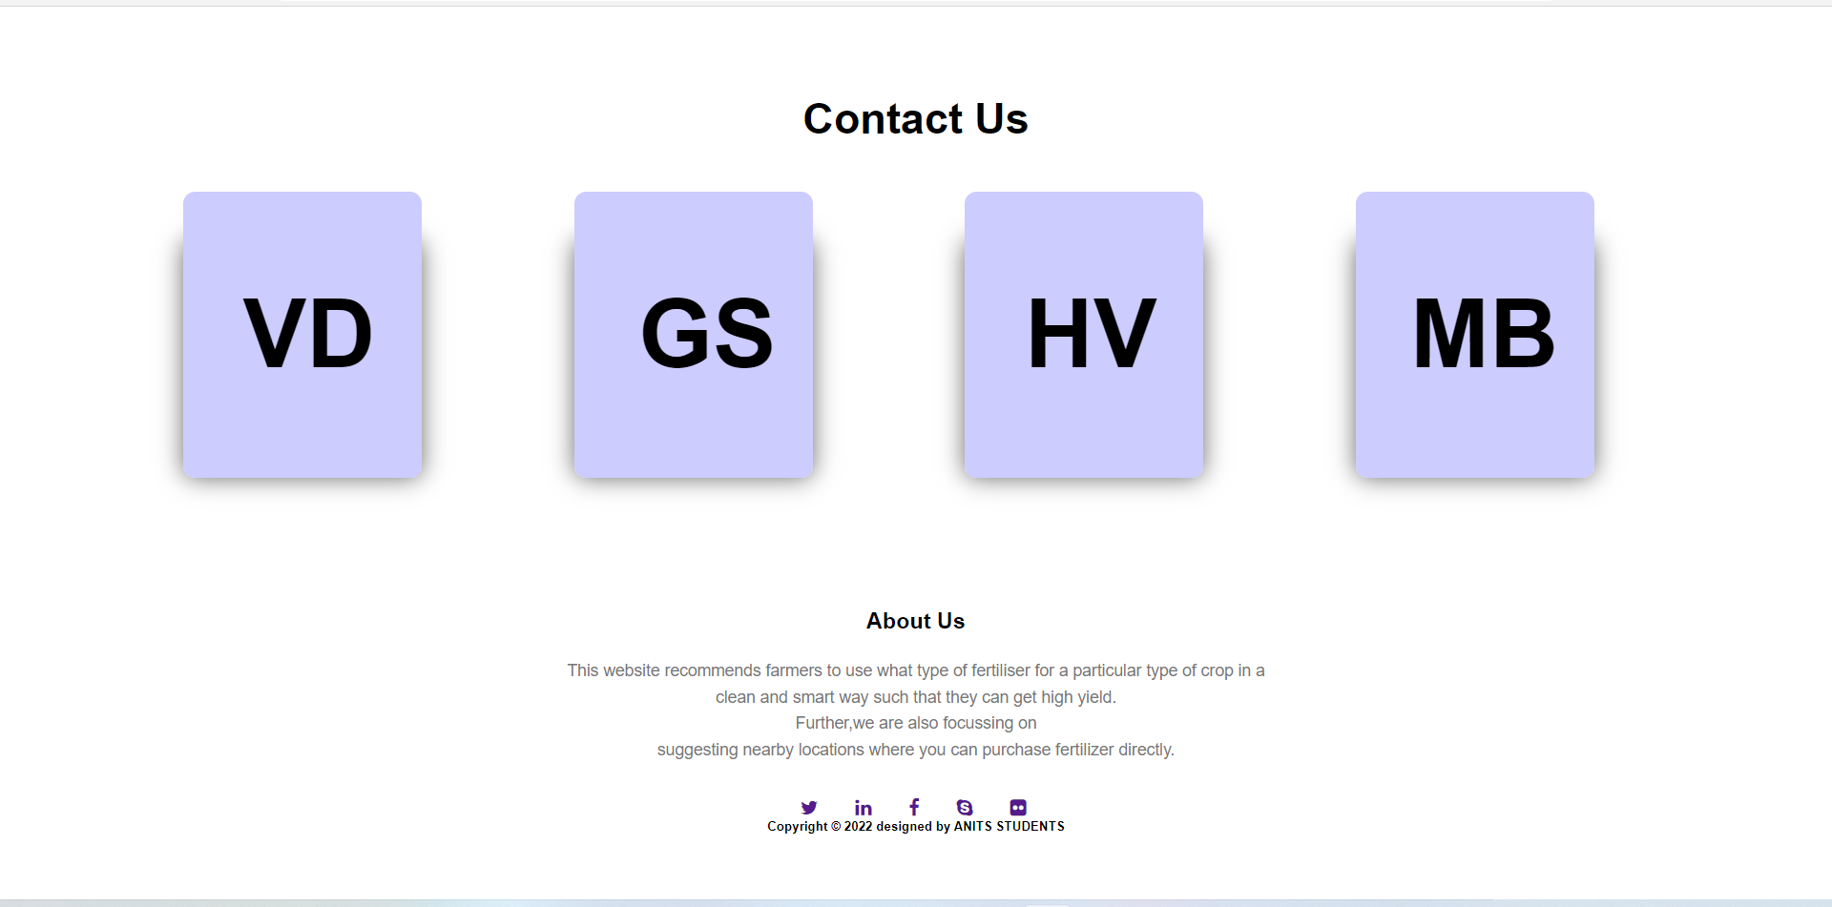

Slide 31
Data base pages:

Slide 32
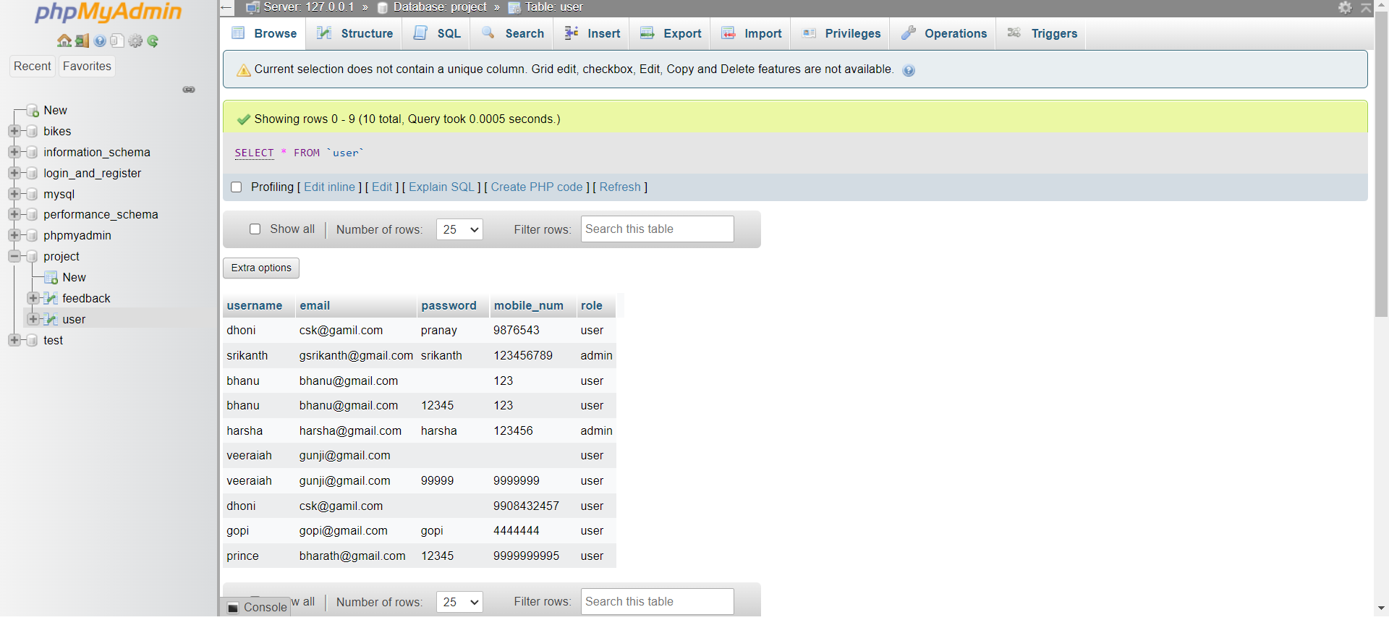

Slide 33
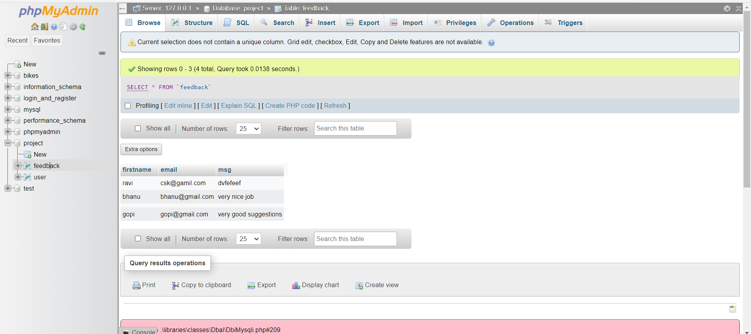
After logging out from website,redirected to login page.

Slide 34
After log out:

Slide 35

THANK YOU!!

